Slide 1

SHREE RAMSWAROOP MEMORIAL UNIVERSITY
Assignment:-2
Java Enterprise Edition Lab - 02
Submitted to:
Submitted by:
Vidushi Srivastava
Mukesh Prajapati
Btech (Cse Industry integrated)
Roll No – 202410101230007

Slide 2
Mastering Database Design for Task Management
Welcome to this lab on designing robust database schemas. Today, we'll explore how to structure data efficiently for a 'Task Management Tool' web application, focusing on tasks, users, and categories.

Slide 3

Prerequisites & Outcomes
Chapter 1: The Foundation
Before we dive into the specifics of schema design, let's ensure we're all on the same page regarding foundational knowledge and what you'll achieve by the end of this session.
1 2
What you should know
Basic relational database concepts Familiarity with SQL syntax Database normalization principles
Requirements for task management systems
What you will learn
Design a relational database schema Create SQL scripts for tables Establish table relationships
Utilize foreign keys effectively

Slide 4
Analyzing Requirements
Chapter 2: The Blueprint
Effective database design begins with a clear understanding of the system's needs. We need to identify the core entities and their essential attributes.
Identify Key Entities
Focus on the primary components of our task management system: Tasks, Users, and Categories. These form the core of our data structure.
1
Determine Attributes
For each entity, pinpoint all necessary information. What data do we need to store about a task, a user, or a category? Think about every detail.
2

Slide 5
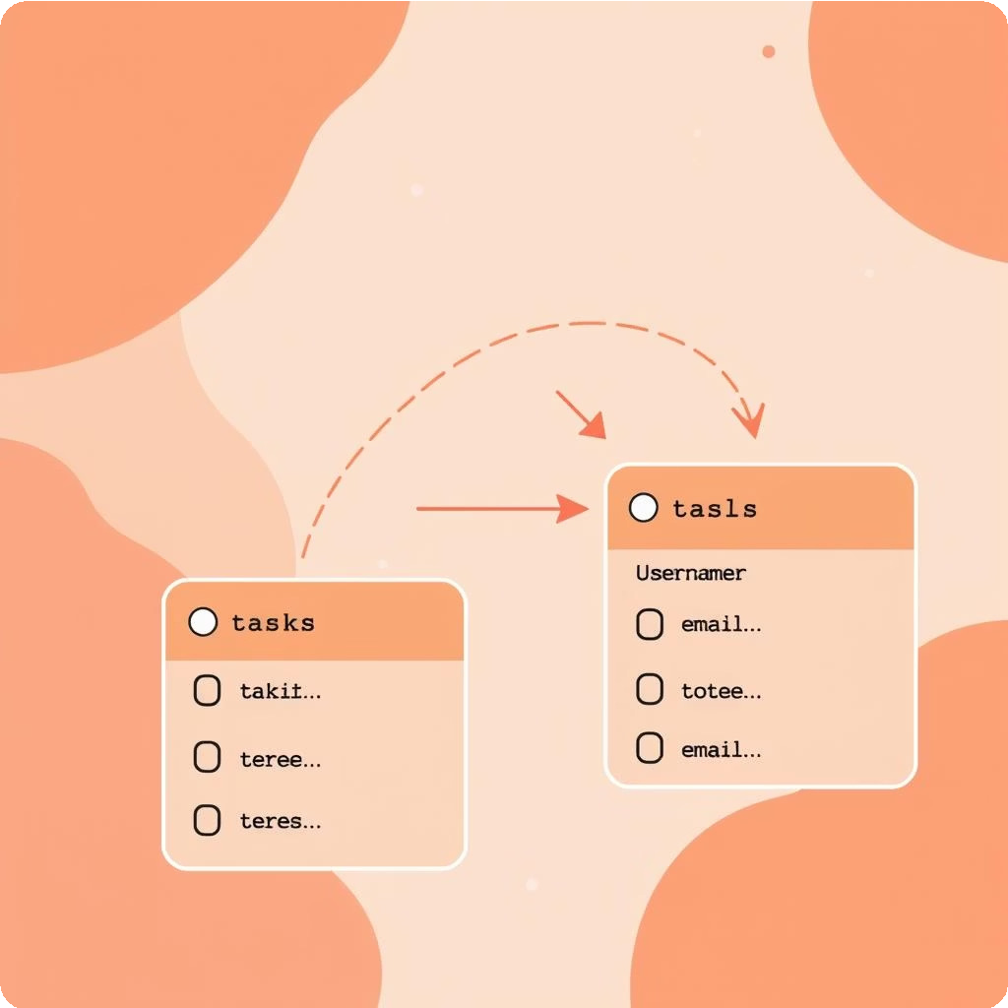

Chapter 3: The Structure
Designing the Core Tables
With our entities defined, we can now structure the tables that will hold our data. Each table will serve a distinct purpose within the database.
Tasks Table
task_id (Primary Key) title, description, deadline
priority, status, completion_percentage category_id (Foreign Key)
Users Table
user_id (Primary Key) username (Unique) password
email (Unique)

Slide 6


Chapter 4: The Connections
Establishing Relationships
The true power of relational databases lies in linking related information. Foreign keys are crucial for maintaining data integrity and enabling meaningful queries.
Categories to Tasks
The Tasks table will reference the Categories table using category_id as a foreign key. This ensures each task belongs to a defined category.
Tasks to Users (Optional)
If tasks can be assigned to multiple users, or users can have multiple tasks, a TaskAssignments table is needed to manage this many-to-many relationship.

Slide 7
Chapter 5: The Code
Writing the SQL Schema
Now, let's translate our design into executable SQL statements. These scripts will define our tables, their columns, data types, and the vital primary and foreign key constraints.
01 02 03
Draft SQL Statements
Write CREATE TABLE statements for each entity, specifying appropriate data types (VARCHAR, INT, TEXT, DATE) and
constraints.
Define Keys
Explicitly declare PRIMARY KEY constraints for unique identifiers and FOREIGN KEY REFERENCES for linking tables.
Ensure Normalization
Verify that the schema adheres to normalization principles, minimizing data redundancy and maximizing integrity.

Slide 8

SQL in Action
Tasks Table Creation
This SQL snippet demonstrates how to create the tasks table, including its unique identifier, task details, and the foreign key link to categories.
CREATE TABLE tasks (
task_id SERIAL PRIMARY KEY, title VARCHAR(255) NOT NULL,
description TEXT, deadline DATE, priority VARCHAR(20),
category_id INT REFERENCES categories(category_id),
status VARCHAR(20), completion_percentage INT
);
Note the SERIAL PRIMARY KEY for auto-incrementing IDs and REFERENCES categories(category_id) for the foreign key.

Slide 9

SQL in Action
Users and Categories Tables
Here are the SQL statements for defining the users and categories tables, including unique constraints for usernames and emails.
CREATE TABLE users (
user_id SERIAL PRIMARY KEY,
username VARCHAR(50) UNIQUE NOT NULL, password VARCHAR(255) NOT NULL,
email VARCHAR(100) UNIQUE NOT NULL
);
CREATE TABLE categories ( category_id SERIAL PRIMARY KEY,
name VARCHAR(100) UNIQUE NOT NULL
);
The UNIQUE NOT NULL constraints ensure data consistency and prevent duplicate entries for usernames, emails, and category names.

Slide 10
Task Assignments (Optional)
SQL in Action
For scenarios where tasks are assigned to specific users, the task_assignments table creates a bridge, managing the many-to- many relationship between tasks and users.
CREATE TABLE task_assignments ( task_id INT REFERENCES tasks(task_id),
user_id INT REFERENCES users(user_id), PRIMARY KEY (task_id, user_id)
);
The PRIMARY KEY (task_id, user_id) defines a composite key, ensuring each task-user assignment is unique.

Slide 11



Chapter 6: Final Steps
Review and Validate
The final, crucial stage is to rigorously review and validate your schema design and SQL scripts. This step ensures that your database is robust, error-free, and perfectly aligned with the application's needs.
Schema Review
Double-check your design against all initial requirements. Does it capture every piece of information and support all intended functionalities?
SQL Validation
Test your SQL scripts. Ensure they execute without errors and create the tables exactly as planned. Identify and correct any syntax issues.

